Slide 1
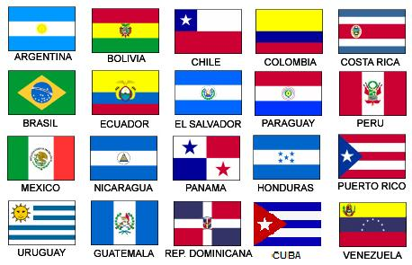
Español III con Senor Bly
rbly@hazelwoodschools.org
Voicemail 314.502.9209
¡Bienvenidos! Continuamos su educación española. ¡No tengan miedo!

Slide 2
Español III
A skill based class focusing on communication
After reviewing some Spanish I/IIconcepts, you will be introduced to these skills (for example, telling someone what to do) thru videos, vocab lists and verb charts posted on Google Classroom and live discussions in Google Meet
We will practice these skills during our Google Meet, games, Quizlet.com, Kahoot and other sources
You are expected to demonstrate these skills thru Google Meet discussions and interviews, Screencastify, Google Slides, frequent formative assessments on Google Forms
Learning a language is a skill attainable by everyone. Look! You already know at least one!

Slide 3
Grading procedures
Classwork - 30%
Classwork, participation, homework, Do now, exit slips
Tests (assessments) - 70%
Speaking tests (interviews), Chapter tests, Projects
There are opportunities to improve test grades if you are not satisfied.

Slide 4
Google Classroom
Class Code: 4th period - 6c62qid 8th period - 7rby5h2
This is our hub, where you will find most of our info, links to resources, schedules, Google Meet links, assignments, and assessments.
There will also be some discussion posts you that you will be asked to participate in.

Slide 5
Google Meet Screencastify
Class discussions Screencastify - Screen Video Recorder
Presenting information Presenting information
Class participation Creating videos
Question / Answer Demonstrate mastery of skills
Clarify concepts Assessments
One-on-one Speaking Assessments

Slide 6
Google Forms Google Slides
Formative Assessments Projects
Exit slips Formative Assessments
Summative Assessments

Slide 7
Repaso 1 El presente - Review 1 (4 weeks)
Students will be able to:
Greet and say goodbye to others, introduce themselves and others
Describe their classroom, friends, family and others
Describe what someone is wearing
Discuss their daily routine
Discuss what they and others want to do / are going to do in the near future
Discuss feelings and emotions

Slide 8
Repaso 2 el pasado - Review 2 (4 weeks)
Students will be able to:
Discuss events that occurred in the past with the preterit
Discuss repeated past actions with the imperfect

Slide 9
Objetivos - learning targets
Capítulo 1 (4 weeks)
Students will be able to:
Narrate and describe past events
Compare and contrast the uses of the preterit and imperfect past tenses

Slide 10
Objetivos - Learning targets
Capítulo 2 el presente perfecto(4 weeks)
Students will be able to:
Discuss what they and others have done recently
Use direct, indirect and double object pronouns

